Slide 1
ENERGY AND POTENTIAL

Slide 2
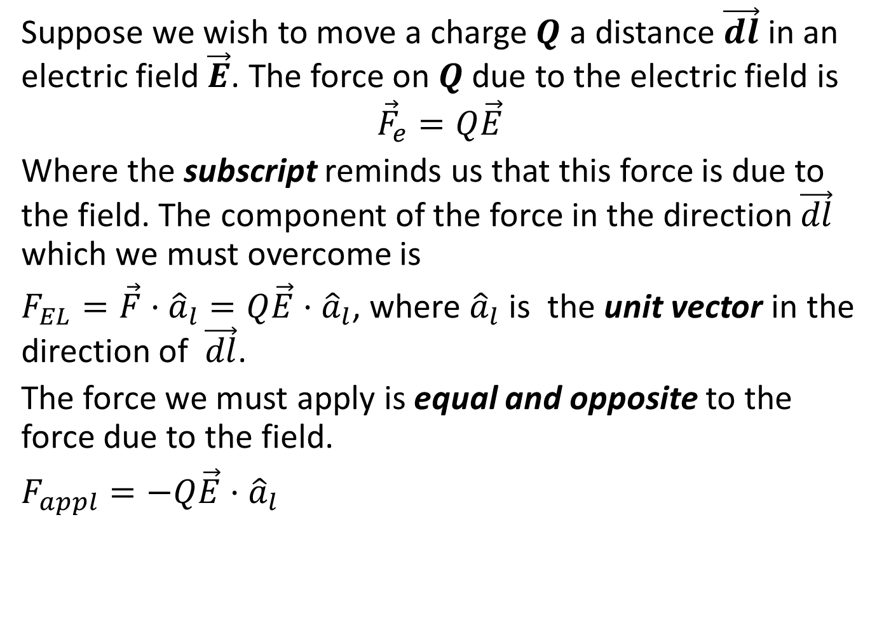
Energy expended in moving a point charge in an electric field
Suppose we wish to move a charge $Q$ a distance $\vec{dl}$ in an electric field $\vec{E}$. The force on $Q$ due to the electric field is
$${\vec{F}}_{e}=Q\vec{E}$$
Where the subscript reminds us that this force is due to the field. The component of the force in the direction $\vec{dl}$ which we must overcome is
$F_{EL}=\vec{F}·{\hat{a}}_{l}=Q\vec{E}·{\hat{a}}_{l}$, where ${\hat{a}}_{l}$ is the unit vector in the direction of $\vec{dl}$.
The force we must apply is equal and opposite to the force due to the field.
$F_{appl}=−Q\vec{E}·{\hat{a}}_{l}$

Slide 3
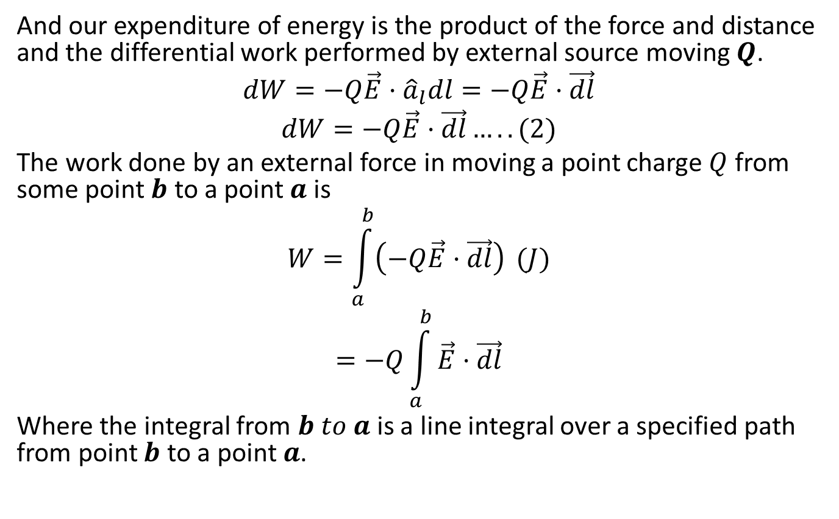
And our expenditure of energy is the product of the force and distance and the differential work performed by external source moving $Q$.
$$dW=−Q\vec{E}·{\hat{a}}_{l}dl=−Q\vec{E}·\vec{dl}$$
$$dW=−Q\vec{E}·\vec{dl}…..(2)$$
The work done by an external force in moving a point charge $Q$ from some point $b$ to a point $a$ is
$$W=\int_{a}^{b}{\left(−Q\vec{E}·\vec{dl}\right)} (J)$$
$$=−Q\int_{a}^{b}{\vec{E}·\vec{dl}}$$
Where the integral from $b to a$is a line integral over a specified path from point $b$ to a point $a$.

Slide 4
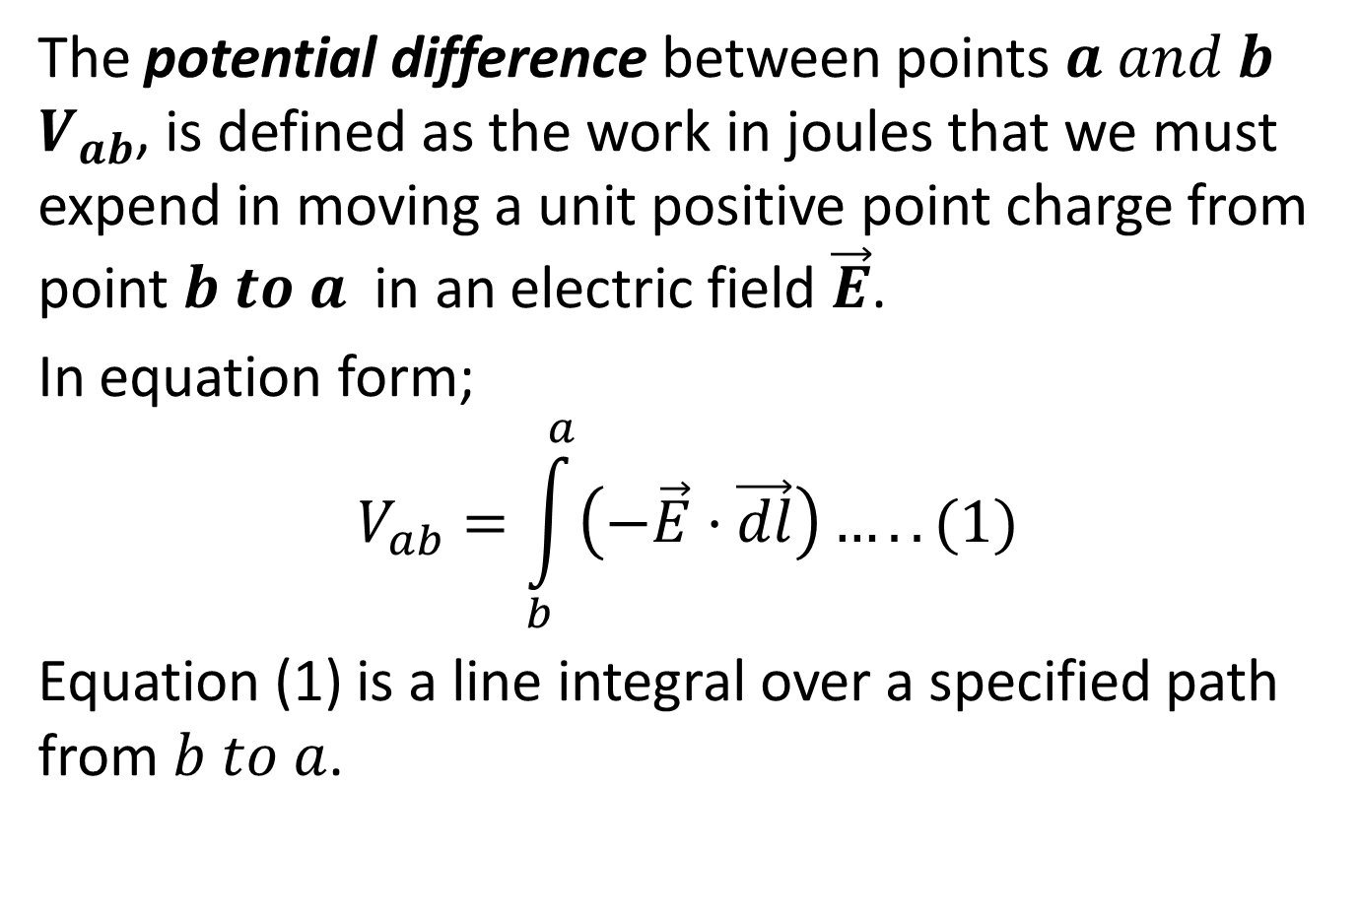
POTENTIAL DIFFERENCE (POTENTIAL) ABOUT A POINT CHARGE
The potential difference between points $a and b$ $V_{ab}$, is defined as the work in joules that we must expend in moving a unit positive point charge from point $b to a$ in an electric field $\vec{E}$.
In equation form;
$$V_{ab}=\int_{b}^{a}{\left(−\vec{E}·\vec{dl}\right)…}..(1)$$
Equation (1) is a line integral over a specified path from $b to a$.

Slide 5
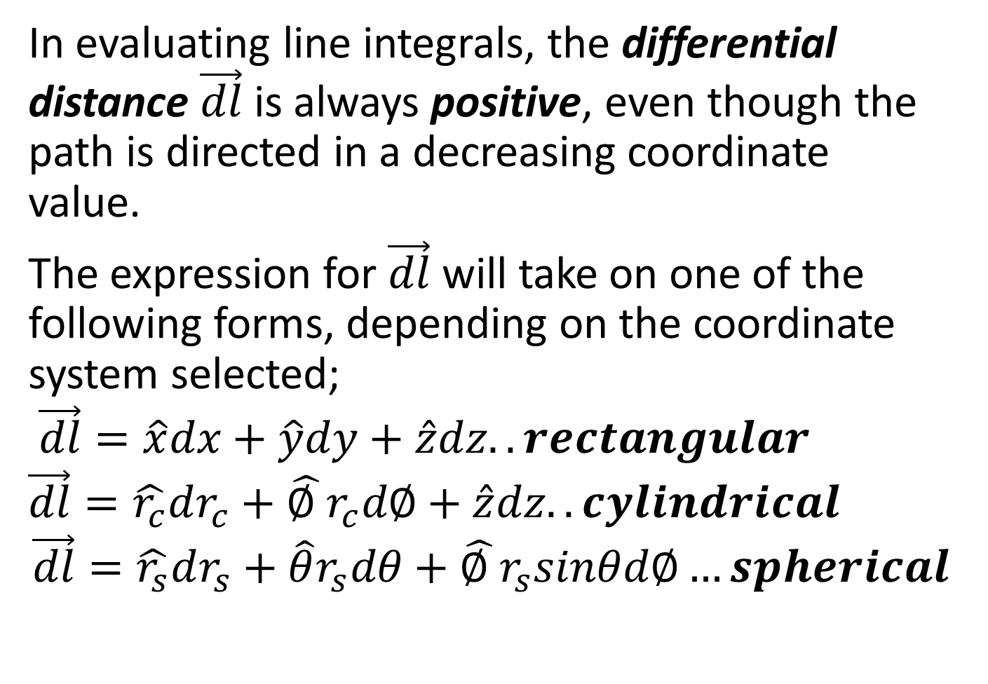
In evaluating line integrals, the differential distance $\vec{dl}$ is always positive, even though the path is directed in a decreasing coordinate value.
The expression for $\vec{dl}$ will take on one of the following forms, depending on the coordinate system selected;
$$\vec{dl}=\hat{x}dx+\hat{y}dy+\hat{z}dz..rectangular$$
$$\vec{dl}=\hat{r_{c}}dr_{c}+\hat{∅ }r_{c}d∅+\hat{z}dz..cylindrical$$
$$\vec{dl}=\hat{r_{s}}dr_{s}+\hat{θ}r_{s}dθ+\hat{∅ }r_{s}sinθd∅…spherical$$

Slide 6
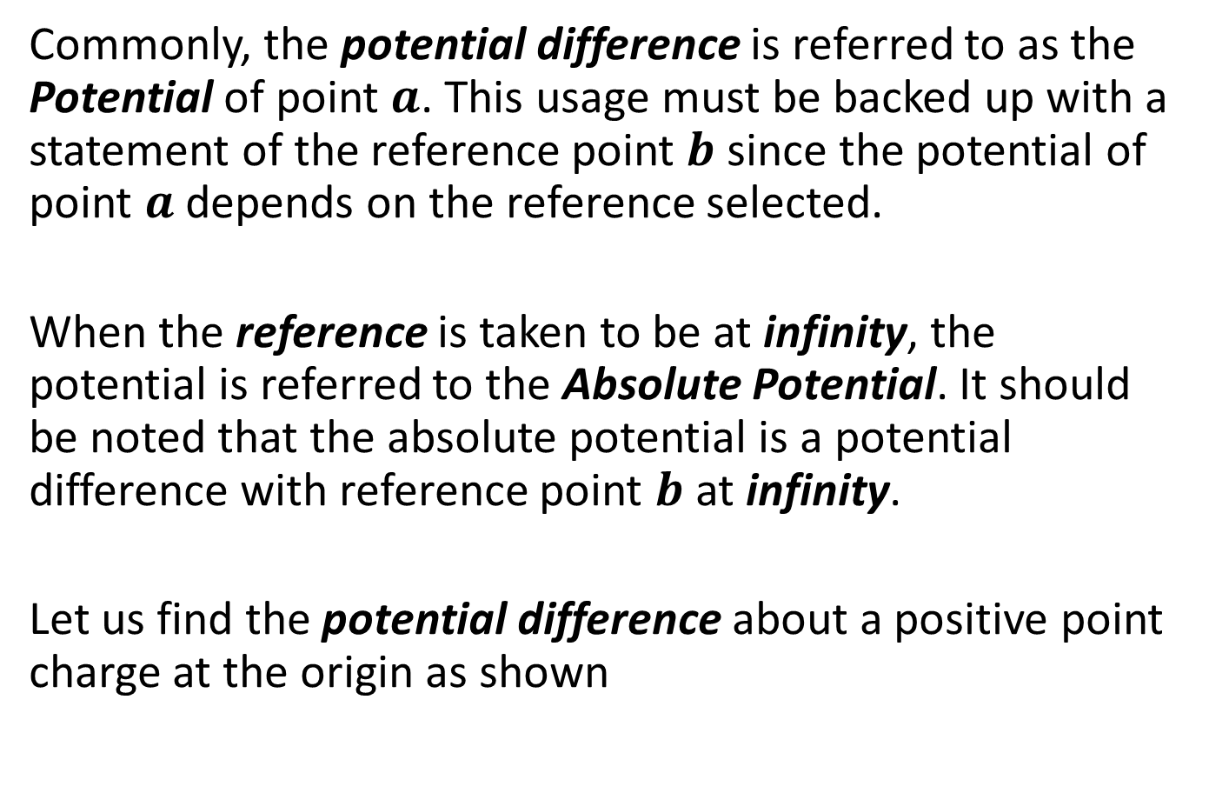
Commonly, the potential difference is referred to as the Potential of point $a$. This usage must be backed up with a statement of the reference point $b$ since the potential of point $a$ depends on the reference selected.
When the reference is taken to be at infinity, the potential is referred to the Absolute Potential. It should be noted that the absolute potential is a potential difference with reference point $b$ at infinity.
Let us find the potential difference about a positive point charge at the origin as shown

Slide 7
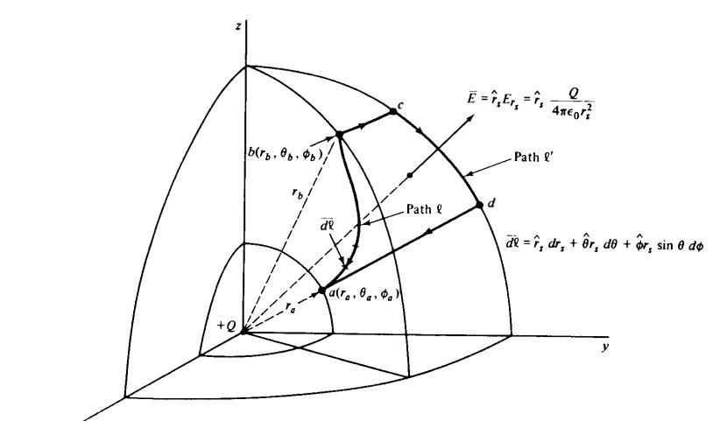

Slide 8
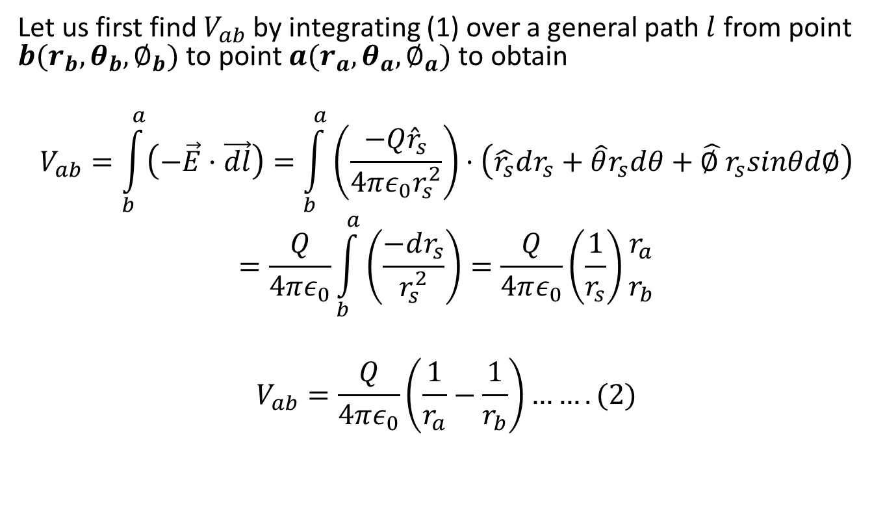
Let us first find $V_{ab}$ by integrating (1) over a general path $l$ from point $b(r_{b},θ_{b},∅_{b})$ to point $a(r_{a},θ_{a},∅_{a})$ to obtain
$$V_{ab}=\int_{b}^{a}{\left(−\vec{E}·\vec{dl}\right)=\int_{b}^{a}{\left(\frac{−Q{\hat{r}}_{s}}{4πε_{0}r_{s}^{2}}\right)·\left(\hat{r_{s}}dr_{s}+\hat{θ}r_{s}dθ+\hat{∅ }r_{s}sinθd∅\right)}}$$
$$=\frac{Q}{4πε_{0}}\int_{b}^{a}{\left(\frac{−dr_{s}}{r_{s}^{2}}\right)=\frac{Q}{4πε_{0}}\left(\frac{1}{r_{s}}\right)}{r_{a} \atop r_{b}}$$
$$V_{ab}=\frac{Q}{4πε_{0}}\left(\frac{1}{r_{a}}−\frac{1}{r_{b}}\right)…….(2)$$

Slide 9
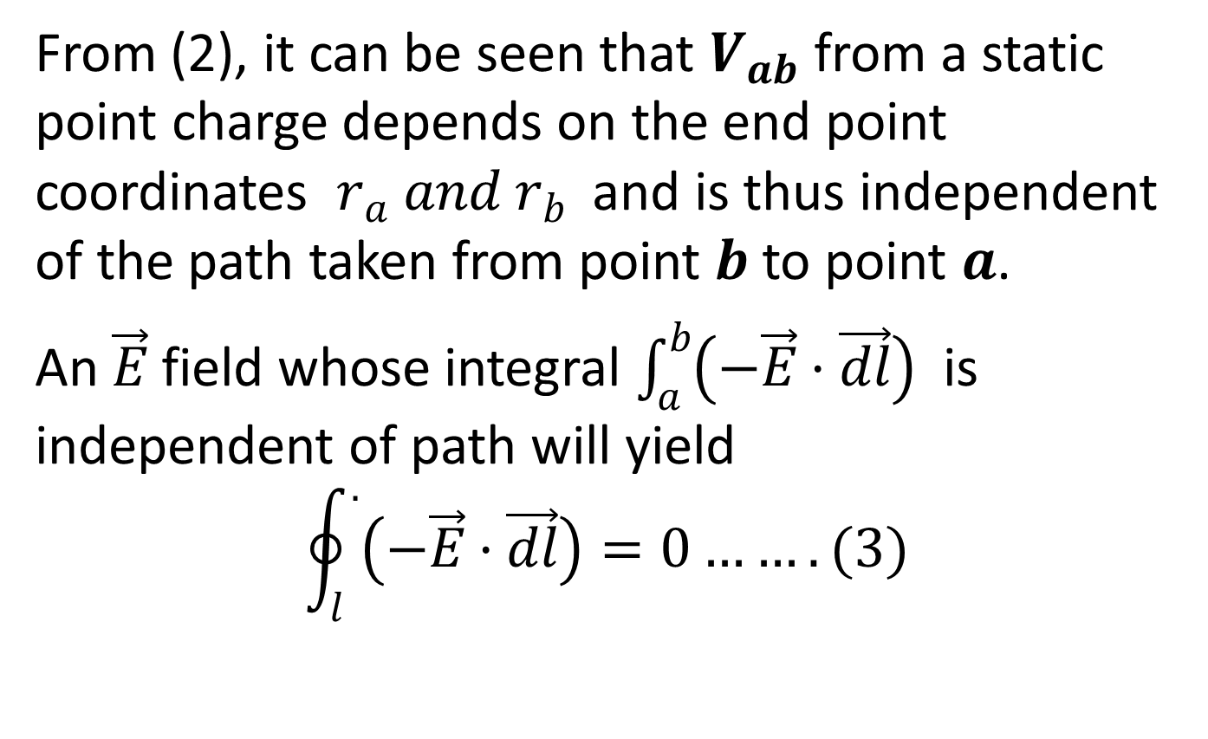
From (2), it can be seen that $V_{ab}$ from a static point charge depends on the end point coordinates $r_{a} and r_{b}$ and is thus independent of the path taken from point $b$ to point $a$.
An $\vec{E}$ field whose integral $\int_{a}^{b}{\left(−\vec{E}·\vec{dl}\right)}$ is independent of path will yield
$$\oint_{l}^{.}{\left(−\vec{E}·\vec{dl}\right)=0…….(3)}$$

Slide 10
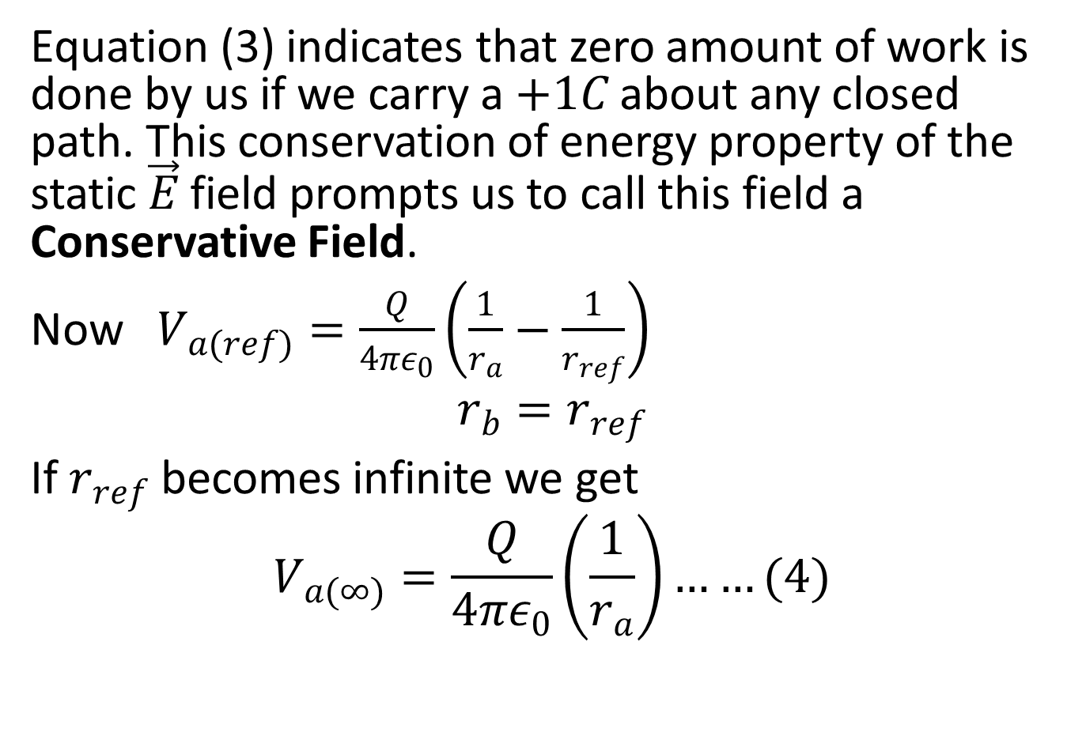
Equation (3) indicates that zero amount of work is done by us if we carry a $+1C$ about any closed path. This conservation of energy property of the static $\vec{E}$ field prompts us to call this field a Conservative Field.
Now $V_{a(ref)}=\frac{Q}{4πε_{0}}\left(\frac{1}{r_{a}}−\frac{1}{r_{ref}}\right)$
$$r_{b}=r_{ref}$$
If $r_{ref}$ becomes infinite we get
$$V_{a(∞)}=\frac{Q}{4πε_{0}}\left(\frac{1}{r_{a}}\right)……(4)$$

Slide 11
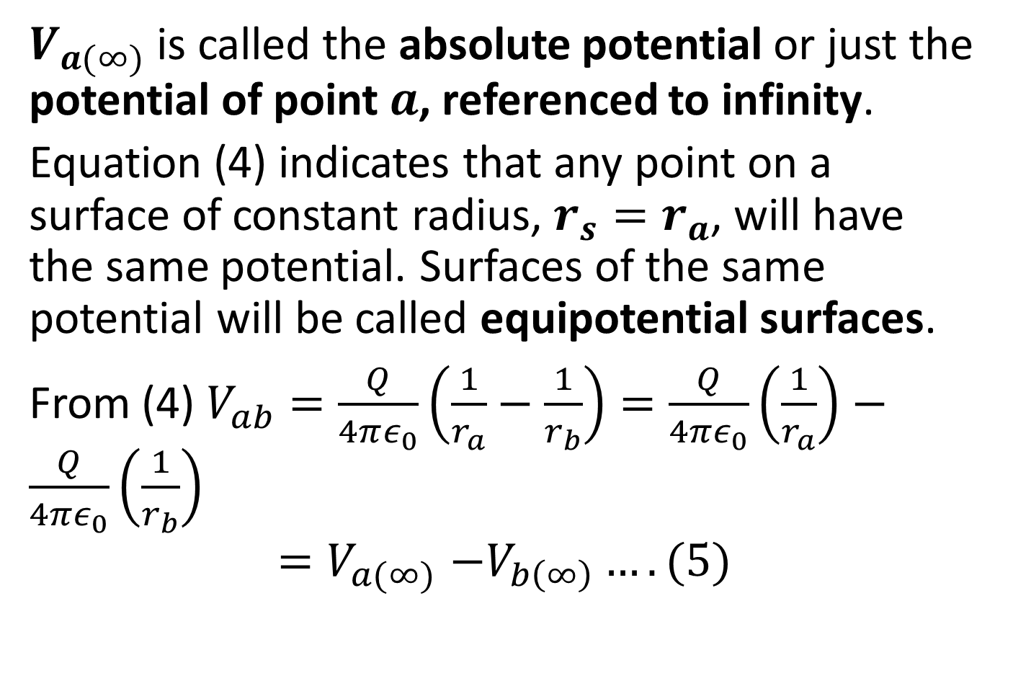
$V_{a(∞)}$ is called the absolute potential or just the potential of point $a$, referenced to infinity.
Equation (4) indicates that any point on a surface of constant radius, $r_{s}=r_{a}$, will have the same potential. Surfaces of the same potential will be called equipotential surfaces.
From (4) $V_{ab}=\frac{Q}{4πε_{0}}\left(\frac{1}{r_{a}}−\frac{1}{r_{b}}\right)=\frac{Q}{4πε_{0}}\left(\frac{1}{r_{a}}\right)−\frac{Q}{4πε_{0}}\left(\frac{1}{r_{b}}\right)$
$${=V}_{a(∞)}−V_{b\left(∞\right)}….(5)$$

Slide 12
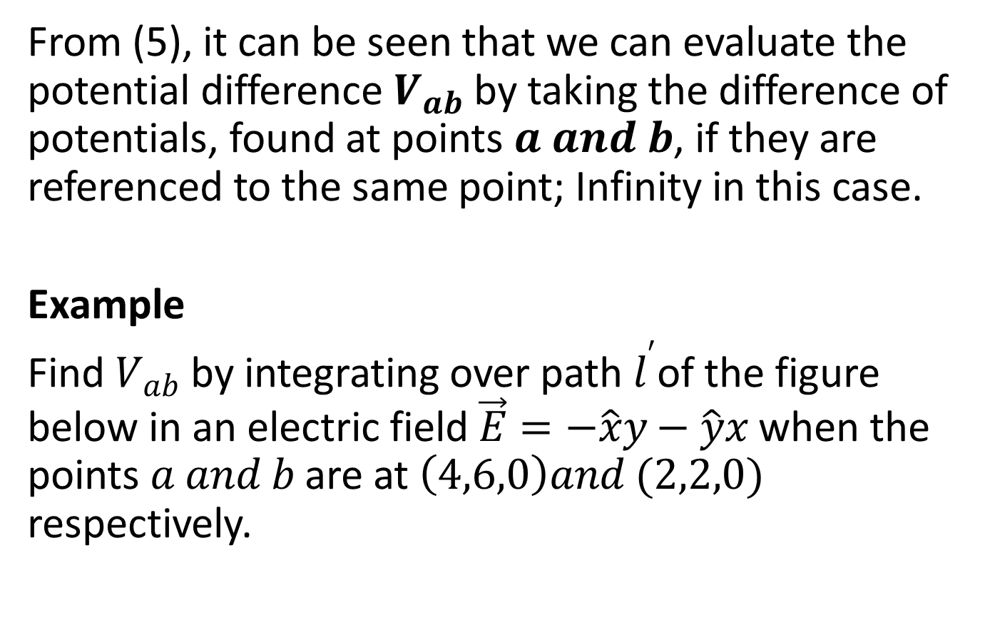
From (5), it can be seen that we can evaluate the potential difference $V_{ab}$ by taking the difference of potentials, found at points $a and b$, if they are referenced to the same point; Infinity in this case.
Example
Find $V_{ab}$ by integrating over path $l^{′}$of the figure below in an electric field $\vec{E}=−\hat{x}y−\hat{y}x$ when the points $a and b$ are at $\left(4,6,0\right)and (2,2,0)$ respectively.

Slide 13
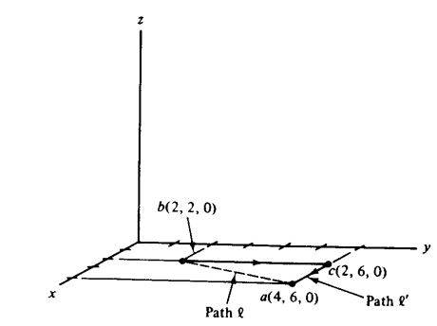

Slide 14
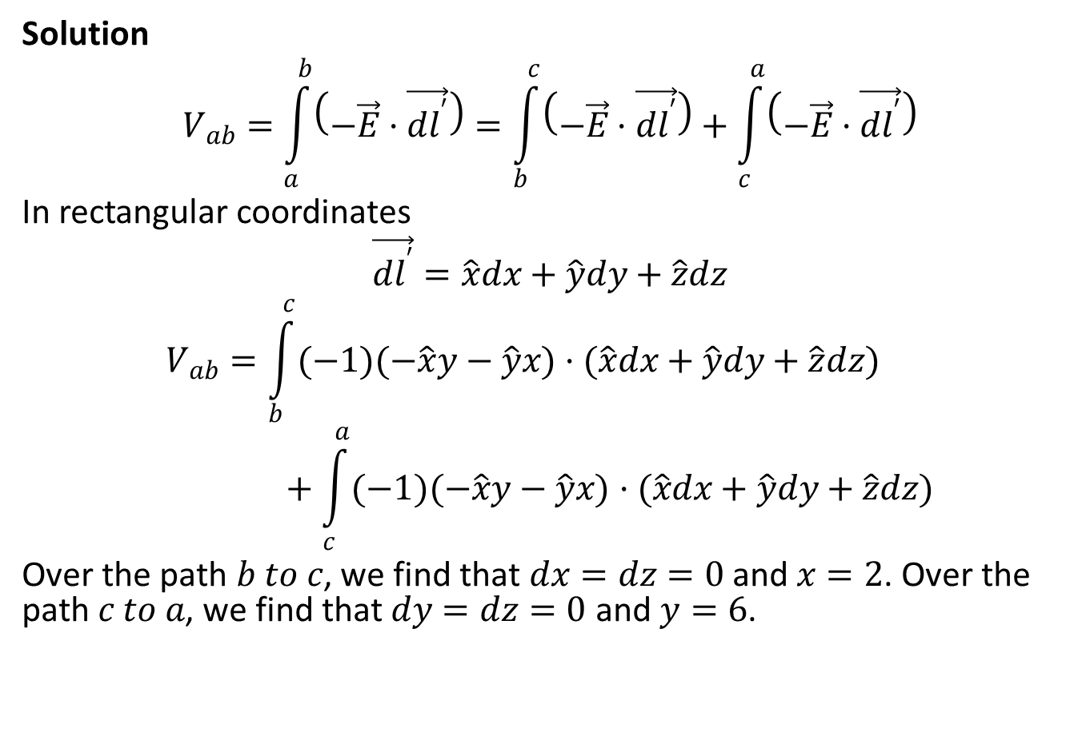
Solution
$$V_{ab}=\int_{a}^{b}{\left(−\vec{E}·\vec{dl^{′}}\right)=\int_{b}^{c}{\left(−\vec{E}·\vec{dl^{′}}\right)}+\int_{c}^{a}{\left(−\vec{E}·\vec{dl^{′}}\right)}}$$
In rectangular coordinates
$$\vec{dl^{′}}=\hat{x}dx+\hat{y}dy+\hat{z}dz$$
$$V_{ab}=\int_{b}^{c}{(−1)(−\hat{x}y−\hat{y}x)·(\hat{x}dx+\hat{y}dy+\hat{z}dz)}+\int_{c}^{a}{(−1)(−\hat{x}y−\hat{y}x)·(\hat{x}dx+\hat{y}dy+\hat{z}dz)}$$
Over the path $b to c$, we find that $dx=dz=0$ and $x=2$. Over the path $c to a$, we find that $dy=dz=0$ and $y=6$.

Slide 15

$$V_{ab}=\int_{b}^{c}{2dy}+\int_{c}^{a}{6dx}=\int_{2}^{6}{2dy}+\int_{2}^{4}{6dx}$$
$$=2\left[6−2\right]+6\left[4−2\right]=8+12=20V$$

Slide 16
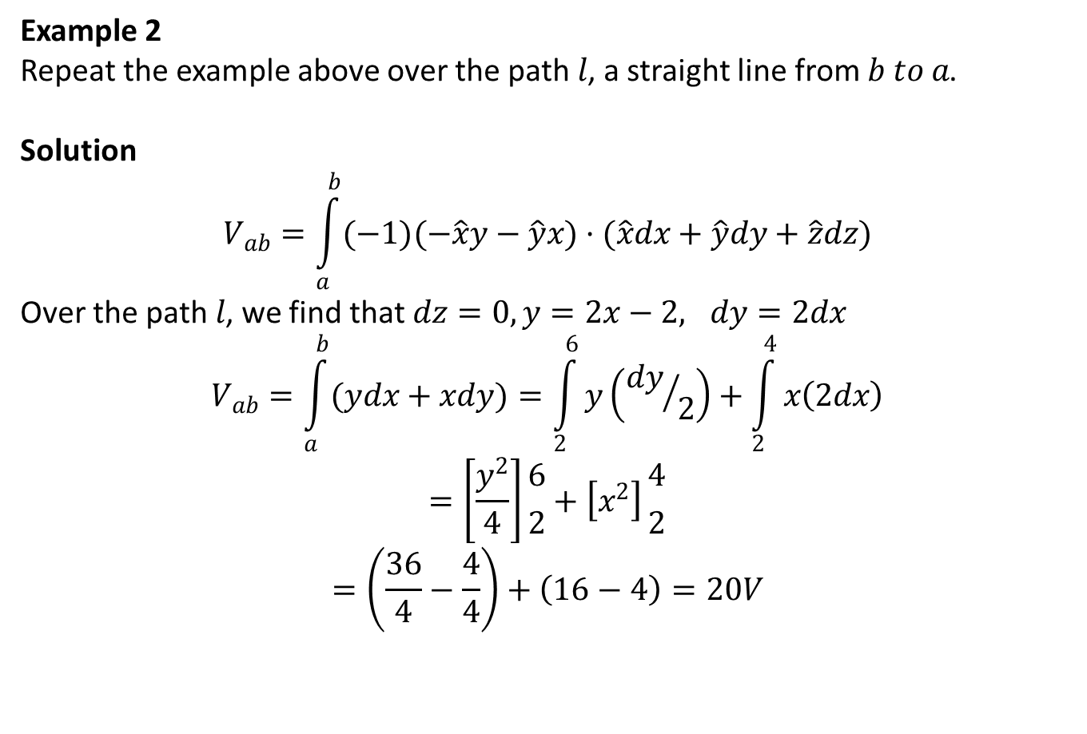
Example 2
Repeat the example above over the path $l$, a straight line from $b to a$.
Solution
$$V_{ab}=\int_{a}^{b}{(−1)(−\hat{x}y−\hat{y}x)·(\hat{x}dx+\hat{y}dy+\hat{z}dz)}$$
Over the path $l$, we find that $dz=0, y=2x−2, dy=2dx$
$$V_{ab}=\int_{a}^{b}{(ydx+xdy)}=\int_{2}^{6}{y\left({dy}/2\right)}+\int_{2}^{4}{x\left(2dx\right)}$$
$$=\left[\frac{y^{2}}{4}\right]{6 \atop 2}+\left[x^{2}\right]{4 \atop 2}$$
$$=\left(\frac{36}{4}−\frac{4}{4}\right)+\left(16−4\right)=20V$$

Slide 17
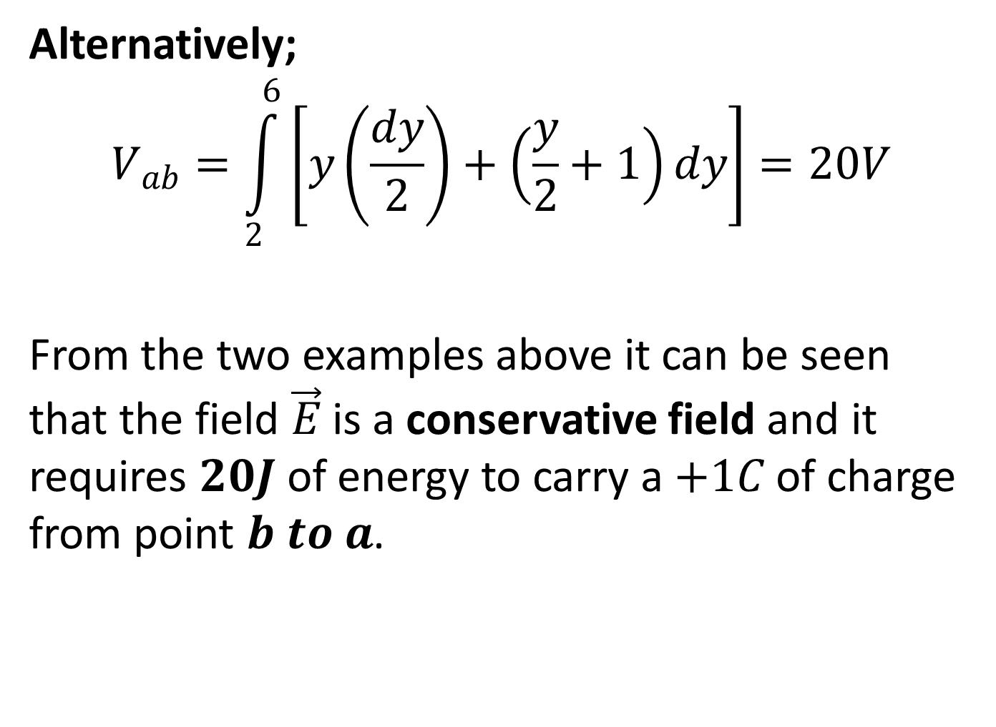
Alternatively;
$$V_{ab}=\int_{2}^{6}{\left[y\left(\frac{dy}{2}\right)+\left(\frac{y}{2}+1\right)dy\right]}=20V$$
From the two examples above it can be seen that the field $\vec{E}$ is a conservative field and it requires $20J$ of energy to carry a $+1C$ of charge from point $b to a$.

Slide 18
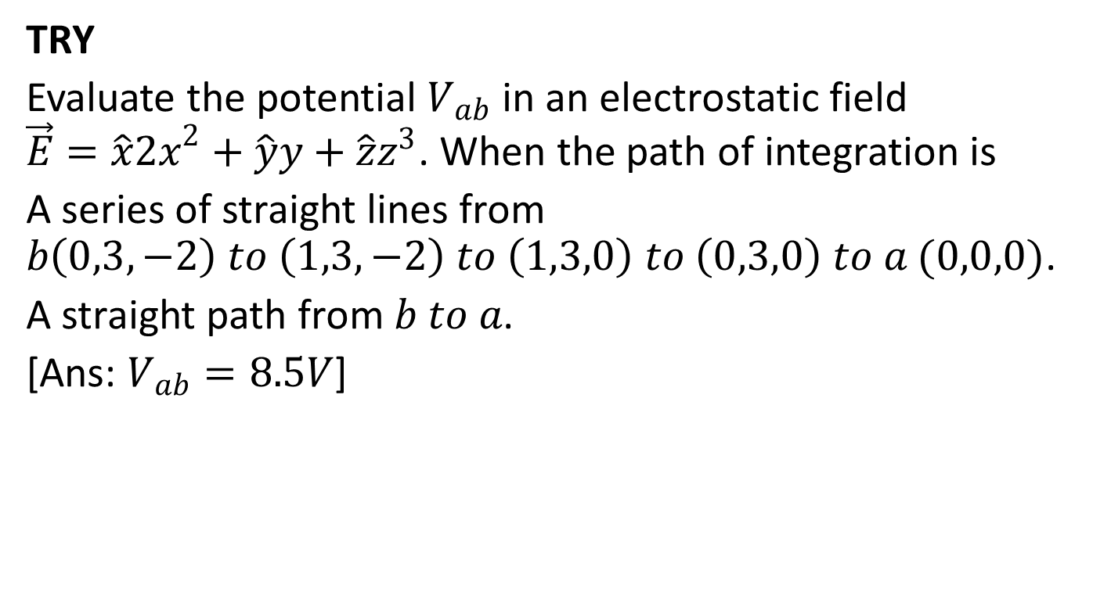
TRY
Evaluate the potential $V_{ab}$ in an electrostatic field $\vec{E}=\hat{x}{2x}^{2}+\hat{y}y+\hat{z}z^{3}$. When the path of integration is
A series of straight lines from $b\left(0,3,−2\right) to \left(1,3,−2\right) to \left(1,3,0\right) to \left(0,3,0\right) to a (0,0,0)$.
A straight path from $b to a$.
[Ans: $V_{ab}=8.5V$]

Slide 19
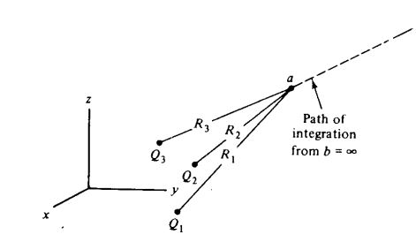

POTENTIAL DIFFERENCE (POTENTIAL) ABOUT A CHARGE SYSTEM
For the system of finite point charges shown below, the absolute potential at point $a$, becomes

Slide 20
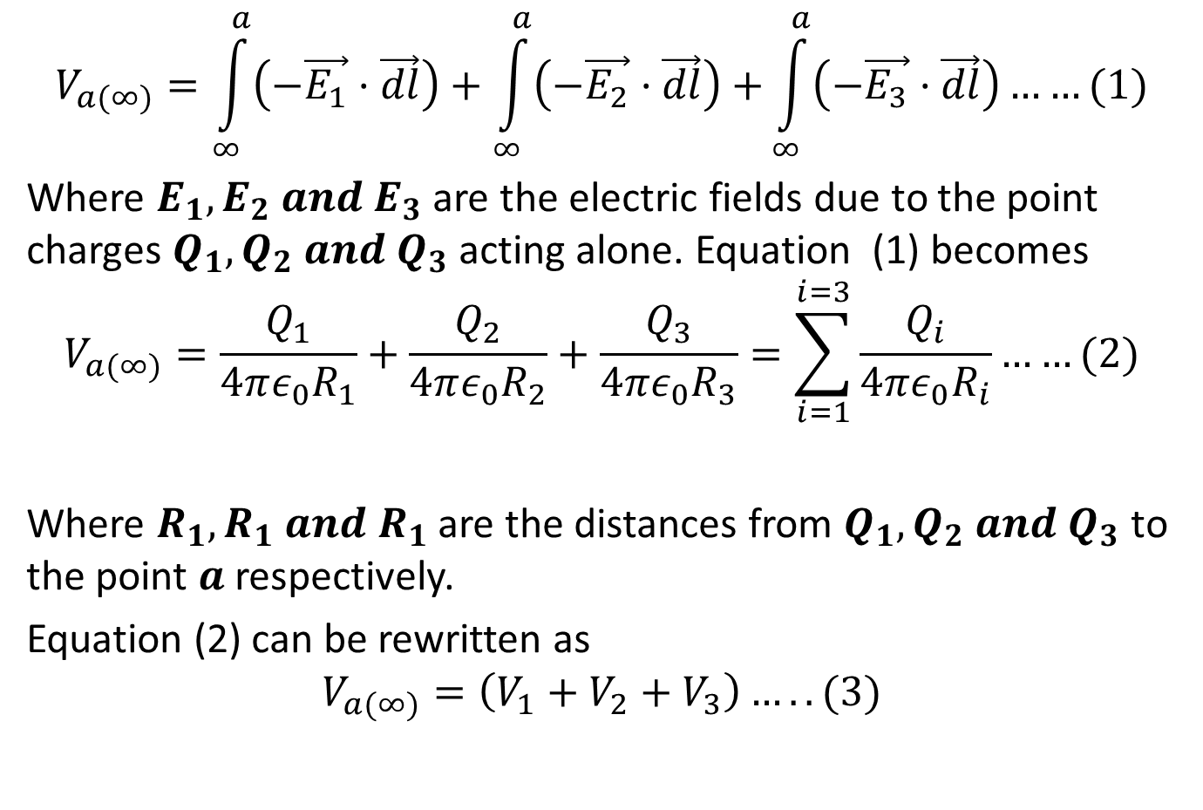
$$V_{a(∞)}=\int_{∞}^{a}{\left(−\vec{E_{1}}·\vec{dl}\right)+\int_{∞}^{a}{\left(−\vec{E_{2}}·\vec{dl}\right)+}\int_{∞}^{a}{\left(−\vec{E_{3}}·\vec{dl}\right)……(1)}}$$
Where $E_{1},E_{2}{ and E}_{3}$ are the electric fields due to the point charges $Q_{1},Q_{2} and Q_{3}$ acting alone. Equation (1) becomes
$$V_{a(∞)}=\frac{Q_{1}}{4πε_{0}R_{1}}+\frac{Q_{2}}{4πε_{0}R_{2}}+\frac{Q_{3}}{4πε_{0}R_{3}}=\sum_{i=1}^{i=3}{\frac{Q_{i}}{4πε_{0}R_{i}}……(2)}$$
Where $R_{1},R_{1} and R_{1}$ are the distances from $Q_{1},Q_{2} and Q_{3}$ to the point $a$ respectively.
Equation (2) can be rewritten as
$$V_{a(∞)}=\left(V_{1}+V_{2}+V_{3}\right)…..(3)$$

Slide 21
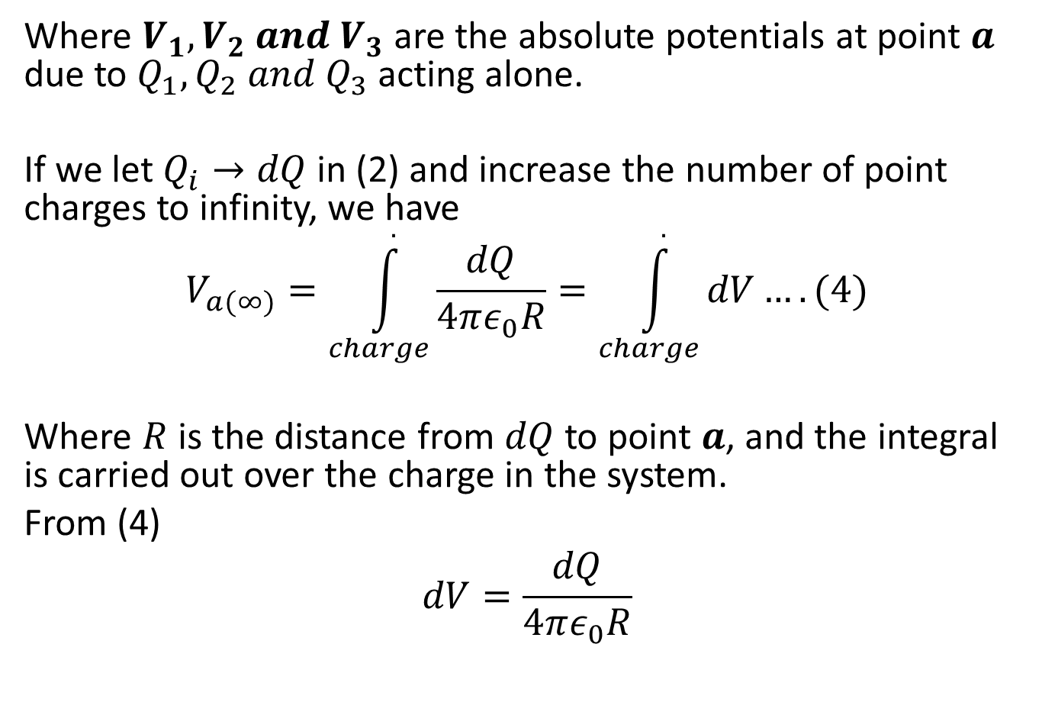
Where $V_{1},V_{2} and V_{3}$ are the absolute potentials at point $a$ due to $Q_{1},Q_{2} and Q_{3}$ acting alone.
If we let $Q_{i}→dQ$ in (2) and increase the number of point charges to infinity, we have
$$V_{a(∞)}=\int_{charge}^{.}{\frac{dQ}{4πε_{0}R}=\int_{charge}^{.}{dV}….(4)}$$
Where $R$ is the distance from $dQ$ to point $a$, and the integral is carried out over the charge in the system.
From (4)
$$dV=\frac{dQ}{4πε_{0}R}$$

Slide 22
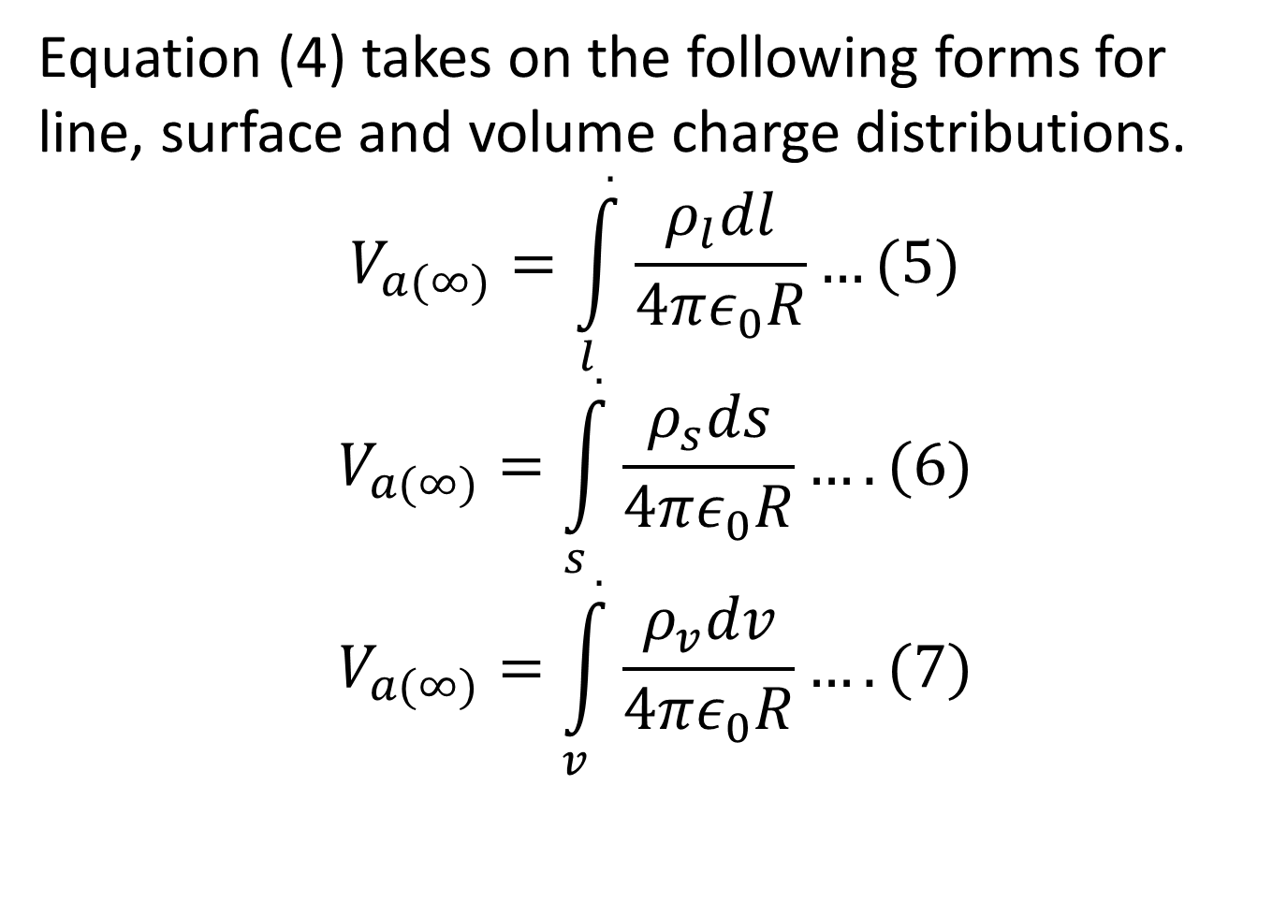
Equation (4) takes on the following forms for line, surface and volume charge distributions.
$$V_{a(∞)}=\int_{l}^{.}{\frac{ρ_{l}dl}{4πε_{0}R}…(5)}$$
$$V_{a(∞)}=\int_{s}^{.}{\frac{ρ_{s}ds}{4πε_{0}R}….(6)}$$
$$V_{a(∞)}=\int_{v}^{.}{\frac{ρ_{v}dv}{4πε_{0}R}….(7)}$$

Slide 23
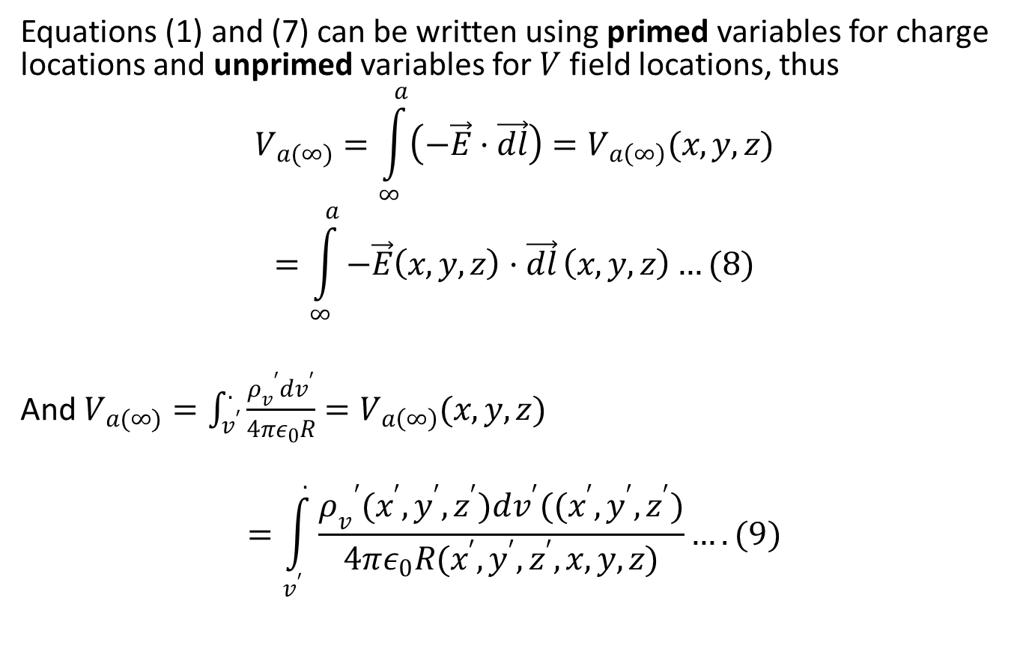
Equations (1) and (7) can be written using primed variables for charge locations and unprimed variables for $V$ field locations, thus
$$V_{a(∞)}=\int_{∞}^{a}{\left(−\vec{E}·\vec{dl}\right)=V_{a\left(∞\right)}(x,y,z)}$$
$$=\int_{∞}^{a}{−\vec{E}\left(x,y,z\right)·\vec{dl}}\left(x,y,z\right)…(8)$$
And $V_{a(∞)}=\int_{v^{′}}^{.}{\frac{{ρ_{v}}^{′}dv^{′}}{4πε_{0}R}}=V_{a\left(∞\right)}(x,y,z)$
$$=\int_{v^{′}}^{.}{\frac{{ρ_{v}}^{′}(x^{′},y^{′},z^{′})dv^{′}((x^{′},y^{′},z^{′})}{4πε_{0}R(x^{′},y^{′},z^{′},x,y,z)}}….(9)$$

Slide 24
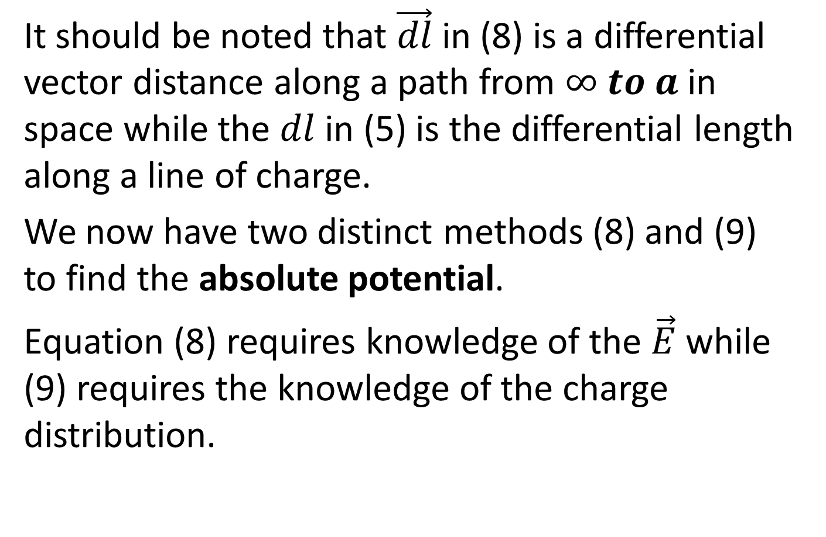
It should be noted that $\vec{dl}$ in (8) is a differential vector distance along a path from $∞ to a$ in space while the $dl$ in (5) is the differential length along a line of charge.
We now have two distinct methods (8) and (9) to find the absolute potential.
Equation (8) requires knowledge of the $\vec{E}$ while (9) requires the knowledge of the charge distribution.

Slide 25
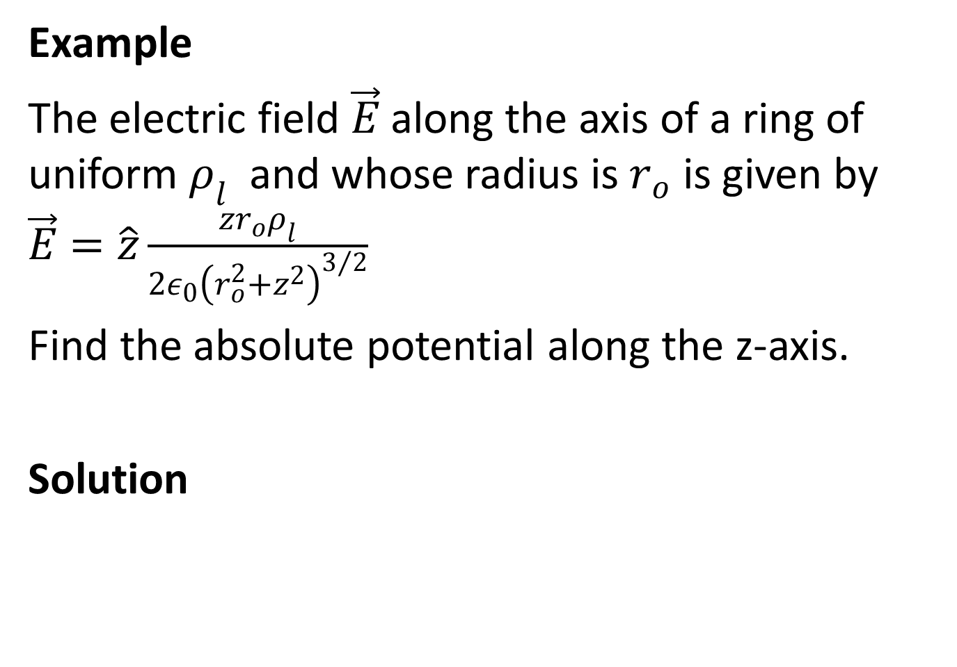
Example
The electric field $\vec{E}$ along the axis of a ring of uniform $ρ_{l}$ and whose radius is $r_{o}$ is given by $\vec{E}=\hat{z}\frac{zr_{o}ρ_{l}}{2ε_{0}{\left(r_{o}^{2}+z^{2}\right)}^{3/2}}$
Find the absolute potential along the z-axis.
Solution

Slide 26
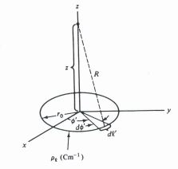
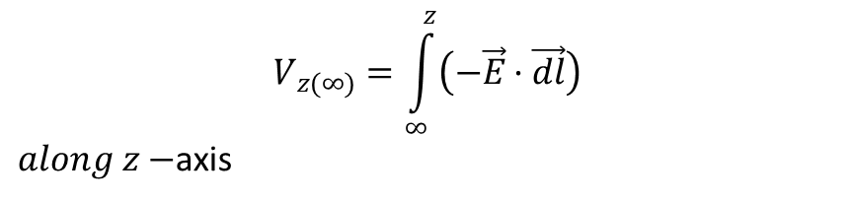

$$V_{z(∞)}=\int_{∞}^{z}{\left(−\vec{E}·\vec{dl}\right)}$$
$along z−$axis
$$dx=dy=0 and \vec{dl}=\hat{z}dz$$

Slide 27
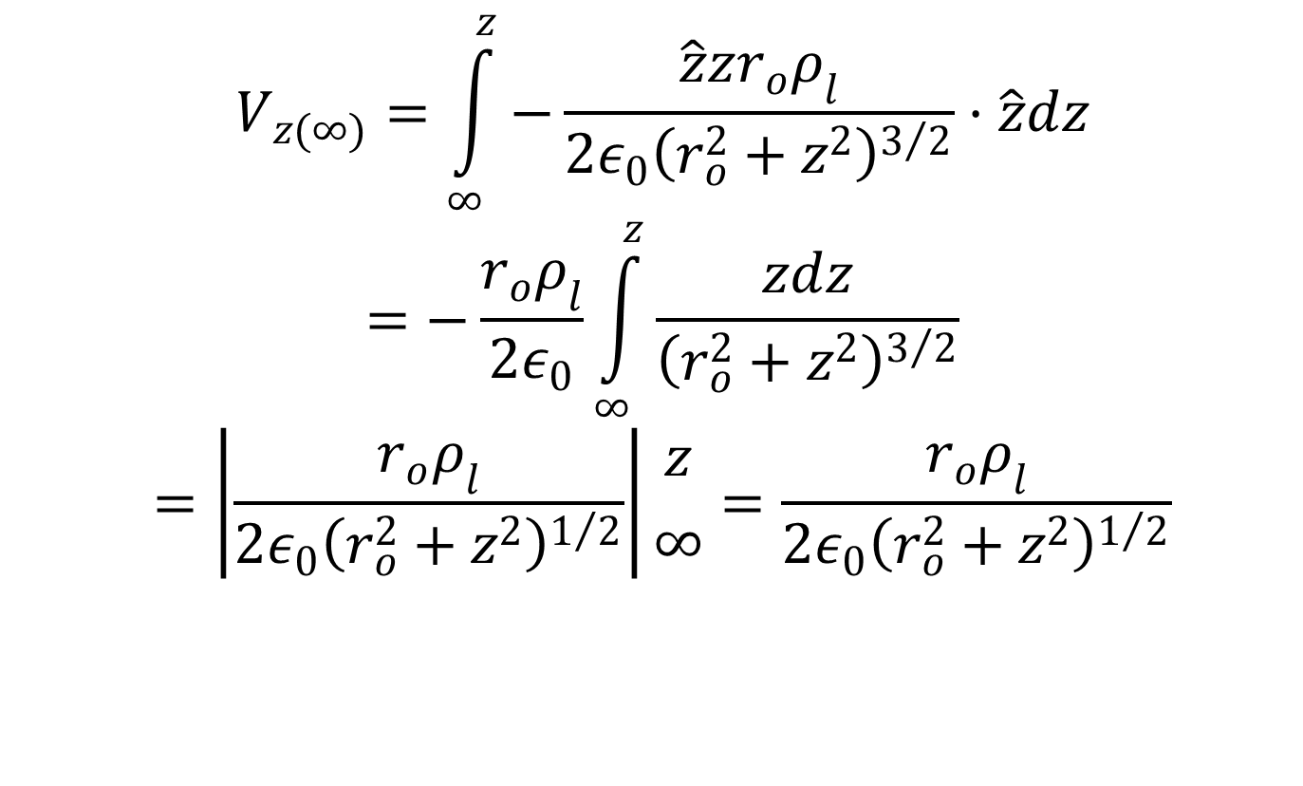
$$V_{z(∞)}=\int_{∞}^{z}{−\frac{\hat{z}zr_{o}ρ_{l}}{2ε_{0}{\left(r_{o}^{2}+z^{2}\right)}^{3/2}}·\hat{z}dz}$$
$$=−\frac{r_{o}ρ_{l}}{2ε_{0}}\int_{∞}^{z}{\frac{zdz}{{\left(r_{o}^{2}+z^{2}\right)}^{3/2}}}$$
$$=\left|\frac{r_{o}ρ_{l}}{2ε_{0}{\left(r_{o}^{2}+z^{2}\right)}^{1/2}}\right|{z \atop ∞}=\frac{r_{o}ρ_{l}}{2ε_{0}{\left(r_{o}^{2}+z^{2}\right)}^{1/2}}$$

Slide 28
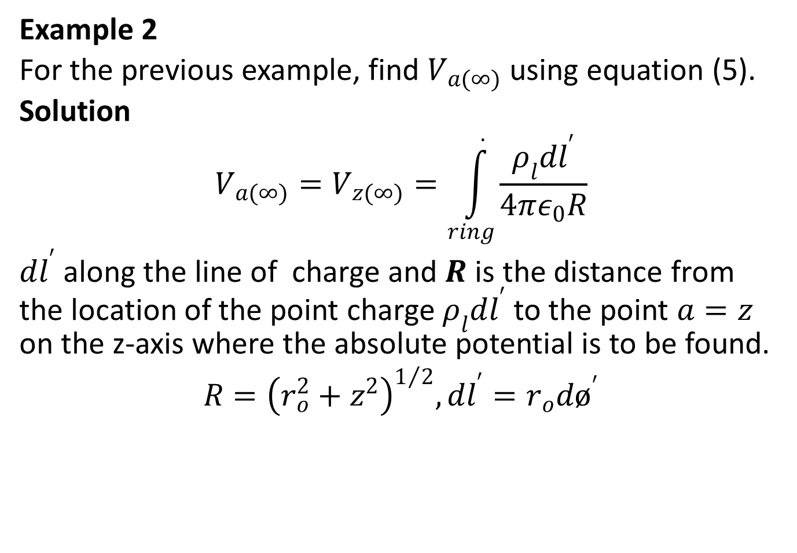
Example 2
For the previous example, find $V_{a(∞)}$ using equation (5).
Solution
$$V_{a(∞)}=V_{z(∞)}=\int_{ring}^{.}{\frac{ρ_{l}dl^{′}}{4πε_{0}R}}$$
$dl^{′}$ along the line of charge and $R$ is the distance from the location of the point charge $ρ_{l}dl^{′}$ to the point $a=z$ on the z-axis where the absolute potential is to be found.
$$R={\left(r_{o}^{2}+z^{2}\right)}^{1/2}, dl^{′}=r_{o}dø^{′}$$

Slide 29
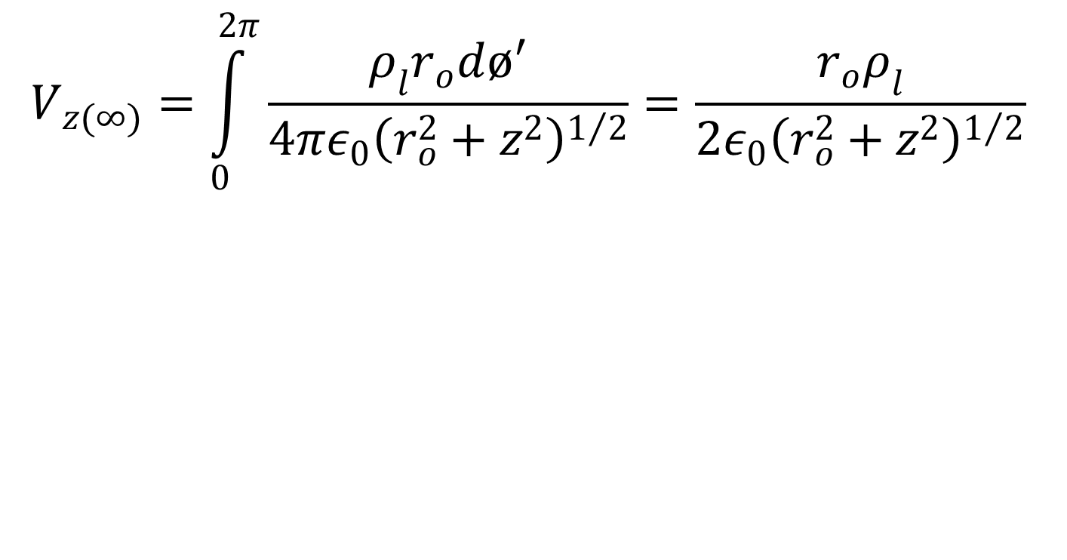
$$V_{z(∞)}=\int_{0}^{2π}{\frac{ρ_{l}r_{o}dø^{′}}{4πε_{0}{\left(r_{o}^{2}+z^{2}\right)}^{1/2}}}=\frac{r_{o}ρ_{l}}{2ε_{0}{\left(r_{o}^{2}+z^{2}\right)}^{1/2}}$$

Slide 30
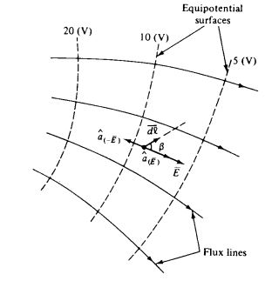

GRADIENT OF A POTENTIAL DIFFERENCE
Now $V_{ab}=\int_{b}^{a}{\left(−\vec{E}·\vec{dl}\right)}$
$$dV=−\vec{E}·\vec{dl}$$

Slide 31
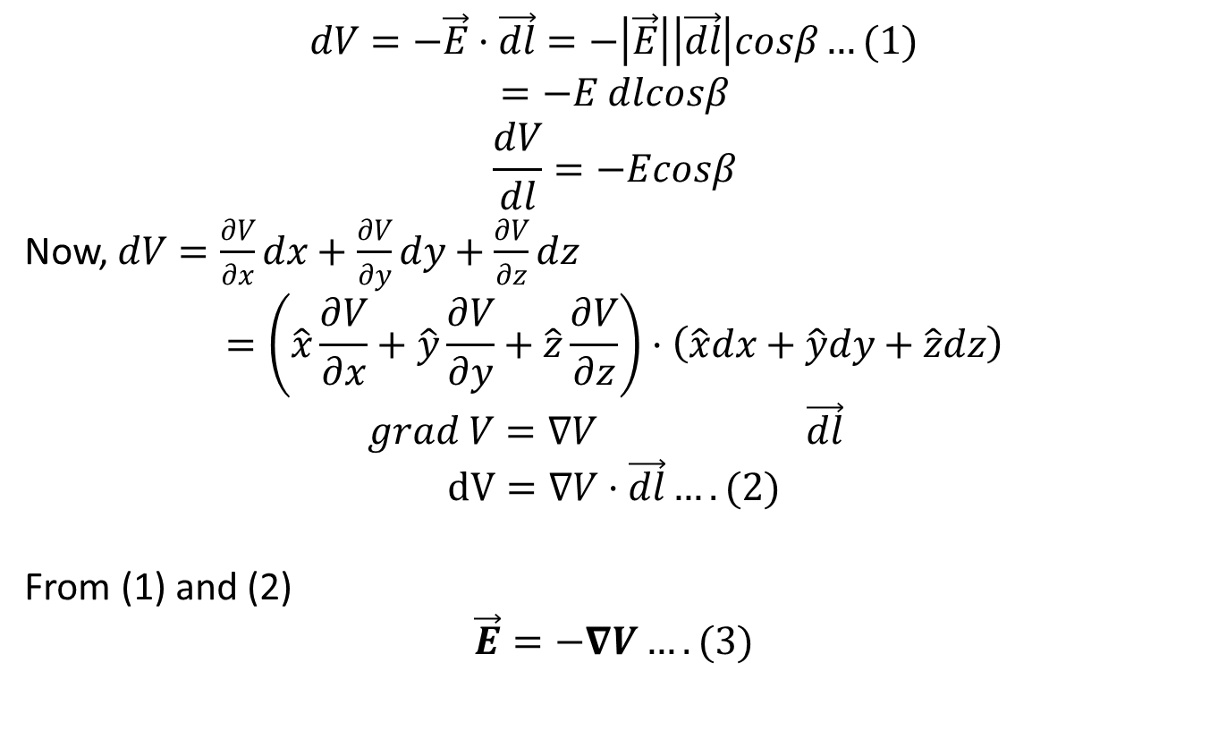
$$dV=−\vec{E}·\vec{dl}=−\left|\vec{E}\right|\left|\vec{dl}\right|cosβ…(1)$$
$$=−E dlcosβ$$
$$\frac{dV}{dl}=−Ecosβ$$
Now, $dV=\frac{∂V}{∂x}dx+\frac{∂V}{∂y}dy+\frac{∂V}{∂z}dz$
$$=\left(\hat{x}\frac{∂V}{∂x}+\hat{y}\frac{∂V}{∂y}+\hat{z}\frac{∂V}{∂z}\right)·\left(\hat{x}dx+\hat{y}dy+\hat{z}dz\right)$$
$$grad V=∇V \vec{dl}$$
$$dV=∇V·\vec{dl}….(2)$$
From (1) and (2)
$$\vec{E}=−∇V….(3)$$

Slide 32
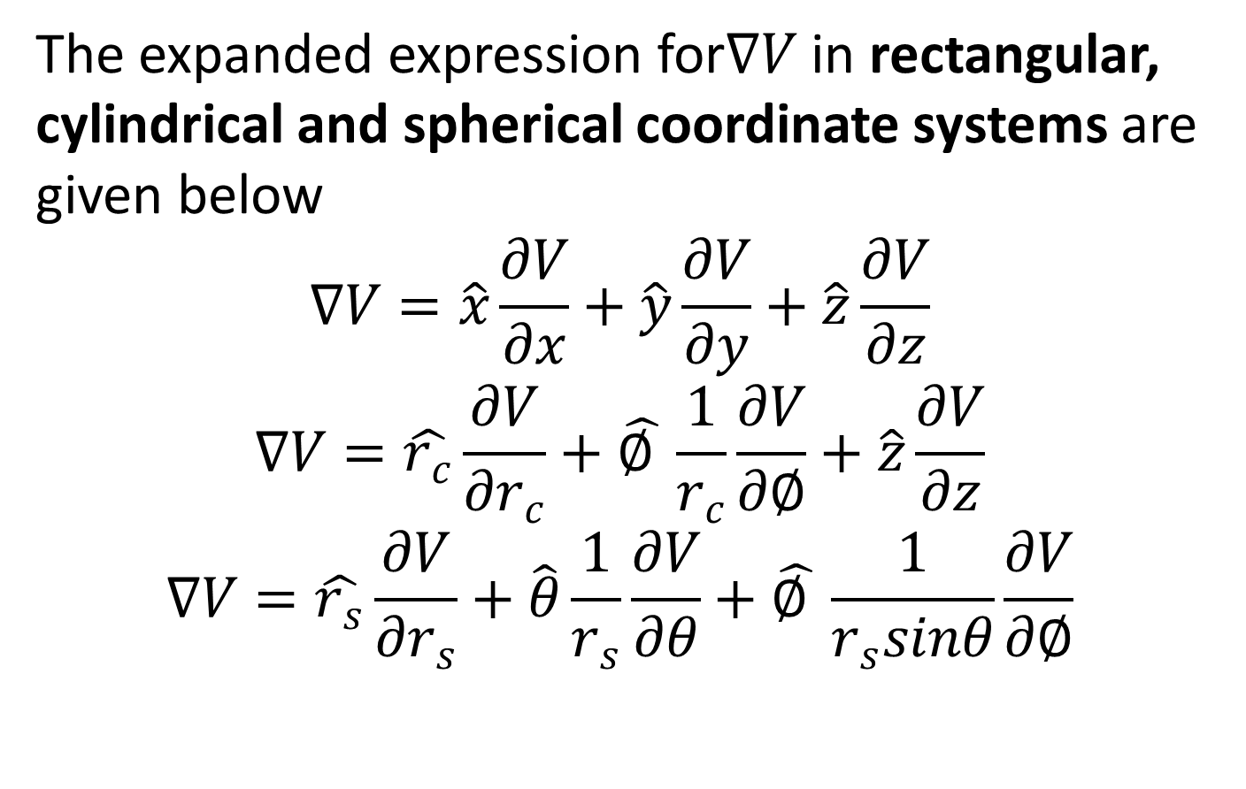
The expanded expression for$∇V$ in rectangular, cylindrical and spherical coordinate systems are given below
$$∇V=\hat{x}\frac{∂V}{∂x}+\hat{y}\frac{∂V}{∂y}+\hat{z}\frac{∂V}{∂z}$$
$$∇V=\hat{r_{c}}\frac{∂V}{∂r_{c}}+\hat{∅ }\frac{1}{r_{c}}\frac{∂V}{∂∅}+\hat{z}\frac{∂V}{∂z}$$
$$∇V=\hat{r_{s}}\frac{∂V}{∂r_{s}}+\hat{θ}\frac{1}{r_{s}}\frac{∂V}{∂θ}+\hat{∅ }\frac{1}{r_{s}sinθ}\frac{∂V}{∂∅}$$

Slide 33
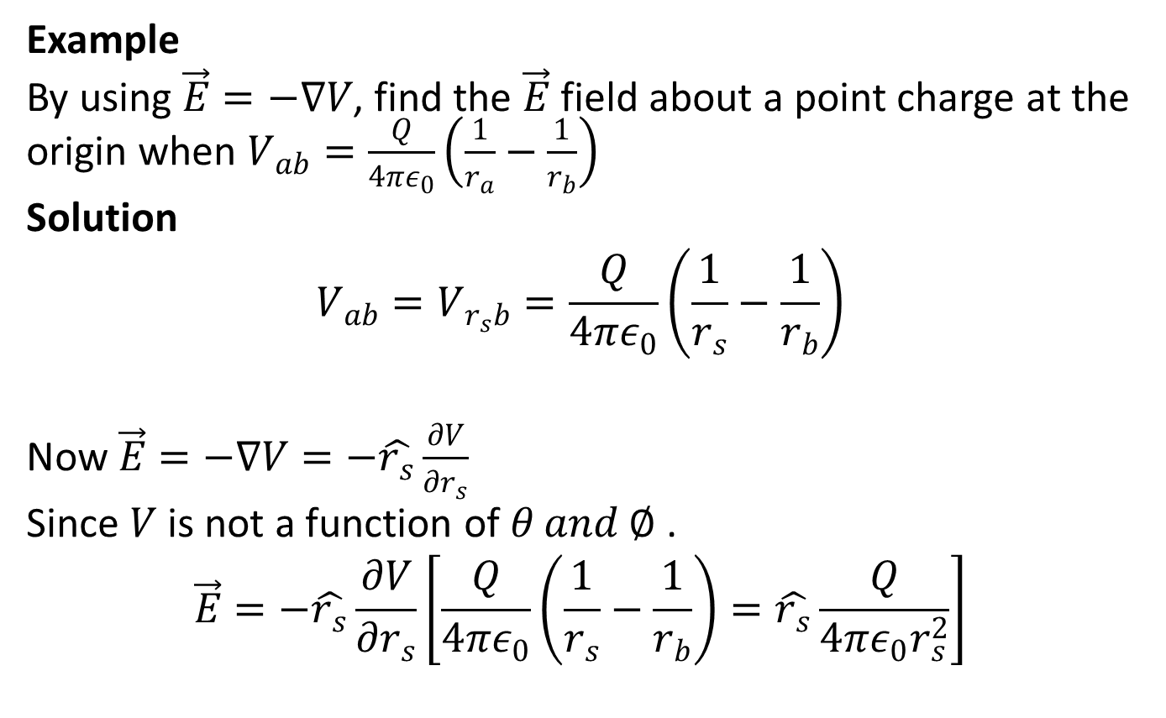
Example
By using $\vec{E}=−∇V$, find the $\vec{E}$ field about a point charge at the origin when $V_{ab}=\frac{Q}{4πε_{0}}\left(\frac{1}{r_{a}}−\frac{1}{r_{b}}\right)$
Solution
$$V_{ab}=V_{r_{s}b}=\frac{Q}{4πε_{0}}\left(\frac{1}{r_{s}}−\frac{1}{r_{b}}\right)$$
Now $\vec{E}=−∇V=−\hat{r_{s}}\frac{∂V}{∂r_{s}}$
Since $V$ is not a function of $θ and ∅$.
$$\vec{E}=−\hat{r_{s}}\frac{∂V}{∂r_{s}}\left[\frac{Q}{4πε_{0}}\left(\frac{1}{r_{s}}−\frac{1}{r_{b}}\right)=\hat{r_{s}}\frac{Q}{4πε_{0}r_{s}^{2}}\right]$$

